Slide 1
An Investigation into Timestamps in NTFS Nathaniel Patrick Teskey 20247672 Dr. Jacqueline Walker
Bachelor of Science in Cyber Security and IT Forensics
Spring semester 2024 Final Presentation

Slide 2
Project Overview
Carried out experiments on Windows 11 into NTFS timestamp behaviour
5 file types (.txt, .docx, .pptx, .pdf, .png)
7 operations (creation, access, contents changed, renamed, copied, moved, deleted)
Folder behaviour was also examined
Examined the efficacy of basic and advanced timestomping tools on Windows 11
Basic: NewFileTime.exe
Advanced: SetMace.exe
Examined the effect of timestomping with NewFileTime and file rename operation on $SI and $FN

Slide 3
Test Environment
HP Pavilion 14 – CE3501na Laptop
Windows 11 Home 10.0.22631
Windows NT 10.0
USB drive – Verbatim Store n’ Go formatted in NTFS
NewFileTime 7.16 GUI application
SetMace 1.0.0.16 by Joakim Schicht
Referenced results of my experiments against SANS Institutes Windows 7 timestamp rules

Slide 4
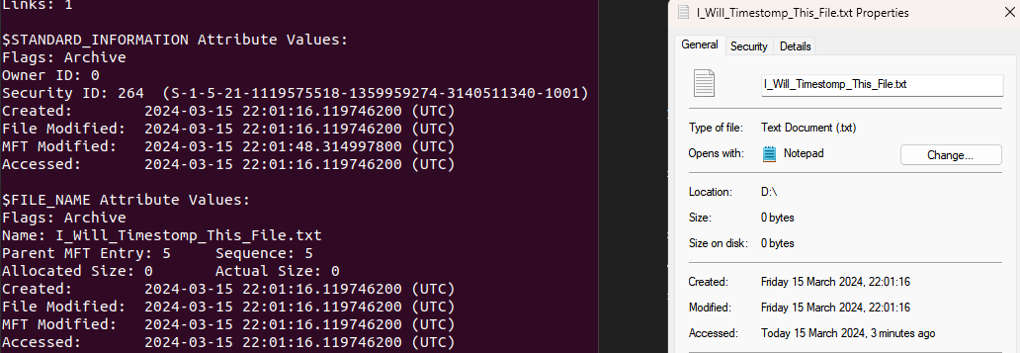
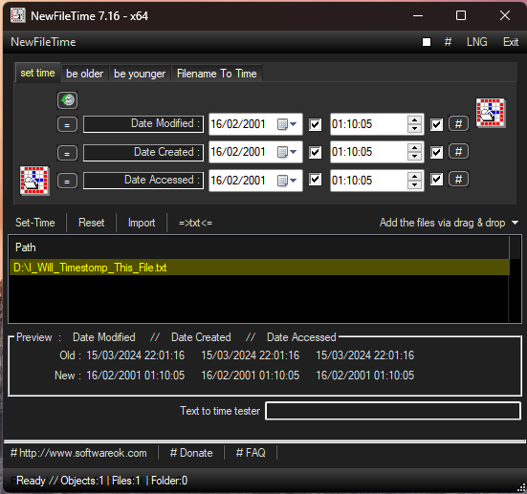
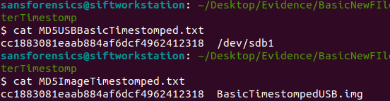
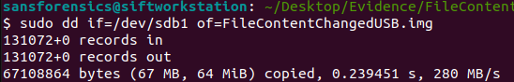
Project Overview Images

Slide 5
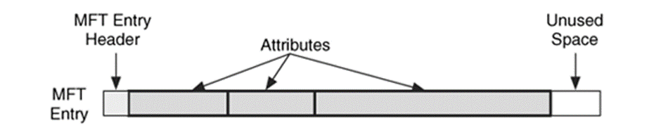
Master File Table in NTFS
Acts as a central database for the volume.
An MFT file record is 1024 bytes with attributes inside it ($SI and $FN are stored here)
MFT keeps a record of itself at $MFT metadata file inside the MFT
Each file has at least one record in the MFT.
Timestamps stored in $SI and $FN attributes Inside MFT record.

Slide 6
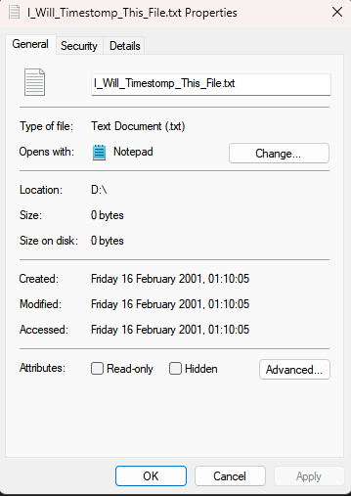
Timestamps in Windows
Timestamps are normally referred to in MACB format.
- “M” stands for modified and is represented by the File Modified timestamps.
- “A” stands for accessed and is represented by the File Accessed timestamps.
- “C” stands for changed and is represented by the MFT Modified timestamps.
- “B” stands for born and is represented by the Created timestamps.
$SI MFT Modified not displayed in Properties View
$FN timestamps are not displayed here either

Slide 7
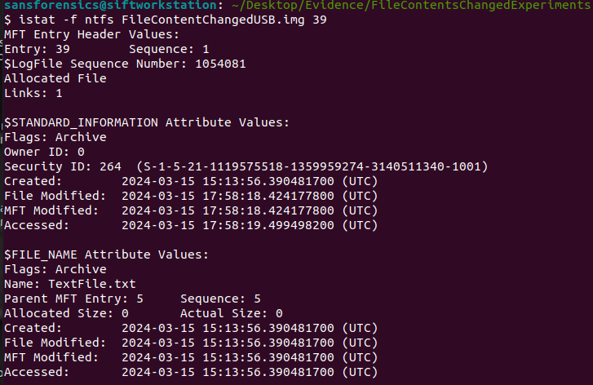
$STANDARD_INFORMATION Attribute
Windows Properties View sources timestamps from here.
$SI Created : creation time of a file on the file system.
$SI Modified : last time content of file was modified.
$SI MFT Modified : last time metadata of file was modified.
Not displayed in Windows Properties View
$SI Accessed : last time file was accessed.
Will only update if system config allows.
Organisations may disable to limit write operations on drive

Slide 8
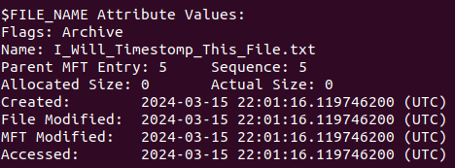
$FILE_NAME Attribute
Typically, not modified by timestomping tools.
Modified by the Windows kernel.
Timestamps are stored in a similar structure to $STANDARD_INFORMATION
$FN Created
$FN Modified
$FN MFT Modified
$FN Accessed
Can inherit same values as $SI timestamps however, not always the case.
Limited information on how they are updated published by Microsoft

Slide 9
Timestamp Extraction Procedure
Operation carried out on file on test device on Windows 11
Test device mounted to SIFT Workstation
MD5 hash of mounted test device is calculated
Raw image of test device taken with “dd” command
MD5 hash of raw image of test device is calculated
MD5 hashes are compared ensuring evidence not altered during extraction
TSK’s “fls” command run to view parsed output of MFT
TSK’s “istat” command run to view MFT entry of test file.
$SI and $FN attribute timestamps are viewed and recorded
Process is repeated for all experiments

Slide 10
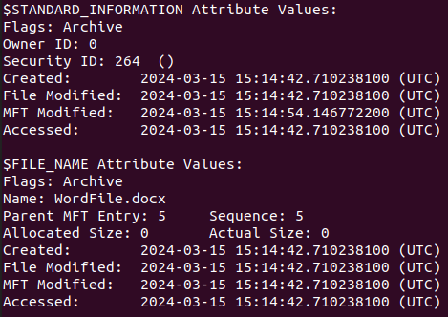
File Created Operation
Word file created
All timestamps legitimate
Most timestamps are the same
$SI MFT Modified shows slightly later time (~10s), could be due to a deferred MFT update by NTFS or that the filesystem was busy and therefore updated MFT Modified slightly later

Slide 11
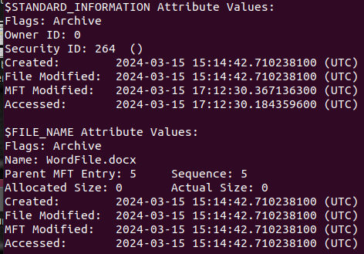
File Accessed Operation
Word file created
All timestamps legitimate
Most timestamps are unchanged
$SI MFT Modified and Accessed updated
$FN all timestamps retain the original creation time

Slide 12
Timestamp Forgery (Timestomping)
Timestomping is the process of falsifying the original valid timestamps of a file in an attempt to obscure the time or date a file was accessed, edited, created or moved.
This project carries out experiments on basic and advanced timestomping software.
Some timestomping methods can appear obvious while others can be more secretive and appear legitimate when investigating.
Evidence of timestomping is normally stored in places like the $LogFile where the time of the operation took place, viewing previous timestamps here may also be possible if it is investigated early.

Slide 13
NewFileTime
Can update $SI timestamps only and not $FN timestamps
Features intuitive GUI – easy for basic PC users to use.
Limited in setting timestamps to 1 second granularity and not nanoseconds, which makes time stamp forgery obvious.
Features drag and drop file feature
Calendars to set timestamps easily.

Slide 14
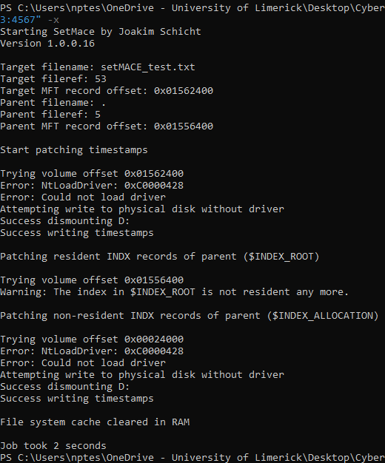
SetMace
Run in Windows PowerShell Admin.
Exits with “Success”, although does not work in Windows 11.
Requires KPP Destroyer to disable PatchGuard security feature after NT 6.1
Last updated in 2014
Downloaded from Joakim Schicht’s (creator) GitHub

Slide 15
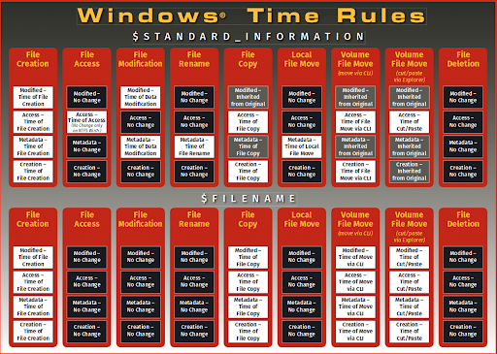
SANS Institute Windows 7 File Time Rules
I compared the results of my experiments with the rules published by SANS Institute for Windows 7.
The key difference was that the file Creation and Deletion operations were the same on Windows 11 and Windows 7.
This is due to file creation displaying the same file times in both $SI and $FN.
All other operations provided different updates to $SI and $FN. A key difference is, most of the time on Windows 7, just one timestamp in the $SI or $FN was changed. On Windows 11 one operation causes changes to many timestamps.

Slide 16
Limitations
Initially tried to use virtual machine, standard Windows 11 VM (80GB disk) and Tiny11 Core VM (8GB disk), Tiny11 was not official Microsoft product and missing standard file system components and drivers.
Used 32GB USB drive, split into 2 partitions. Used 64MB partition for experiments. Necessary for performing experiments as MD5 hash calculation and creating raw image took far too long
Test device was sufficient for viewing MFT and timestamps, however contained corrupted $LogFile and other metadata files which would have been interesting to examine – due to it being a partition and not an entire NTFS volume.
Write blocker could not be used due to VirtualBox’s way of mounting USB drives. Physical write blocker was too expensive (~$400) to purchase but would have worked. Files were not modified when mounted anyway but write blocker would have been beneficial in following best forensic practices.

Slide 17
Potential uses of the and future work
Determine timestamps of files in a Windows operating system, determining if the timestamps are genuine or not.
Develop tool to extract timestamps from a parsed MFT .csv file to record results and carry out experiments more quickly.
Analyse SetMace and determine the reason it is not working in Windows 11, possibly develop new, working version of KPP Destroyer to disable Windows security driver in Windows 11.

Slide 18
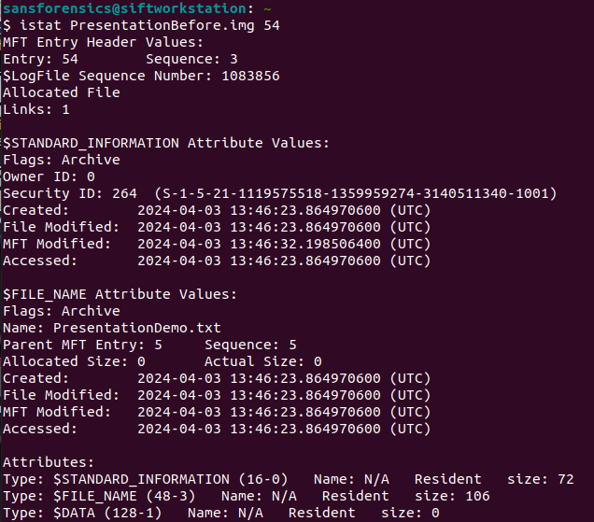
Demonstration
Goals
Demonstrate procedure of viewing $STANDARD_INFORMATION and $FILE_NAME timestamps
Demonstrate timestomping with NewFileTime.exe and Rename
View Timestomped file times
Determine if timestomping was effective
Note files original timestamps before demo
Tools Used
Windows 11
NewFileTime.exe
USB Drive – Test Device
SIFT Workstation
The Slueth Kit

Slide 19
Conclusion and Main Insights Gained
Gained an insight into Timestamp behaviour in NTFS
Found out that timestamps in Windows 7 and Windows 11 follow different rules
Gained experience in forensic procedures and good practice
Found out that NewFileTime and file rename operation copies some forged $SI timestamps to $FN.
Found out that SetMace is now patched on Windows 11.

Slide 20
Thank you. Any questions?

